Slide 1
Generating QR Codes
in Pure Ruby
Choosing a gem, dependencies and testing
James Crisp

Slide 2
Why?
▪ RiskAssess Chemical Register
▪ Emergency services
▪ Printed codes
▪ Stocktake: desktop -> phone
Notes:
Story starts long ago in 2007…

Slide 3
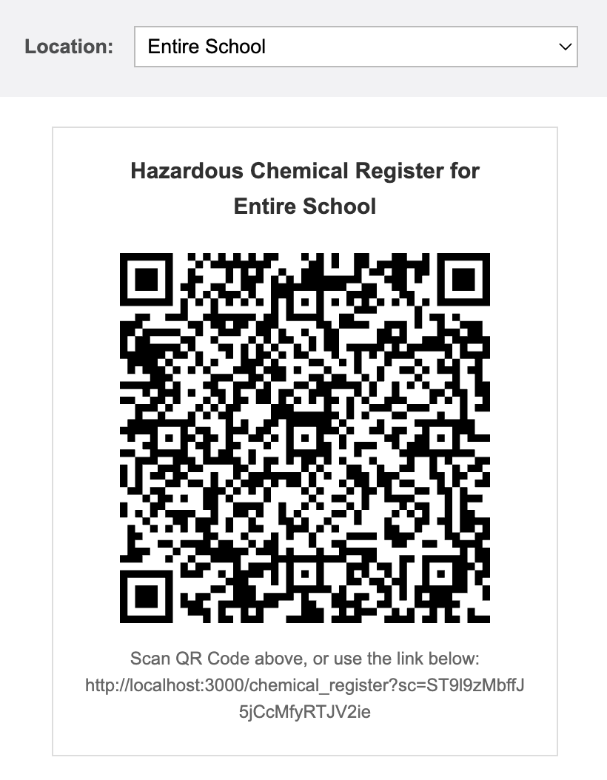
The Entire School QR Code
Pick a location → new code, new link.

Slide 4
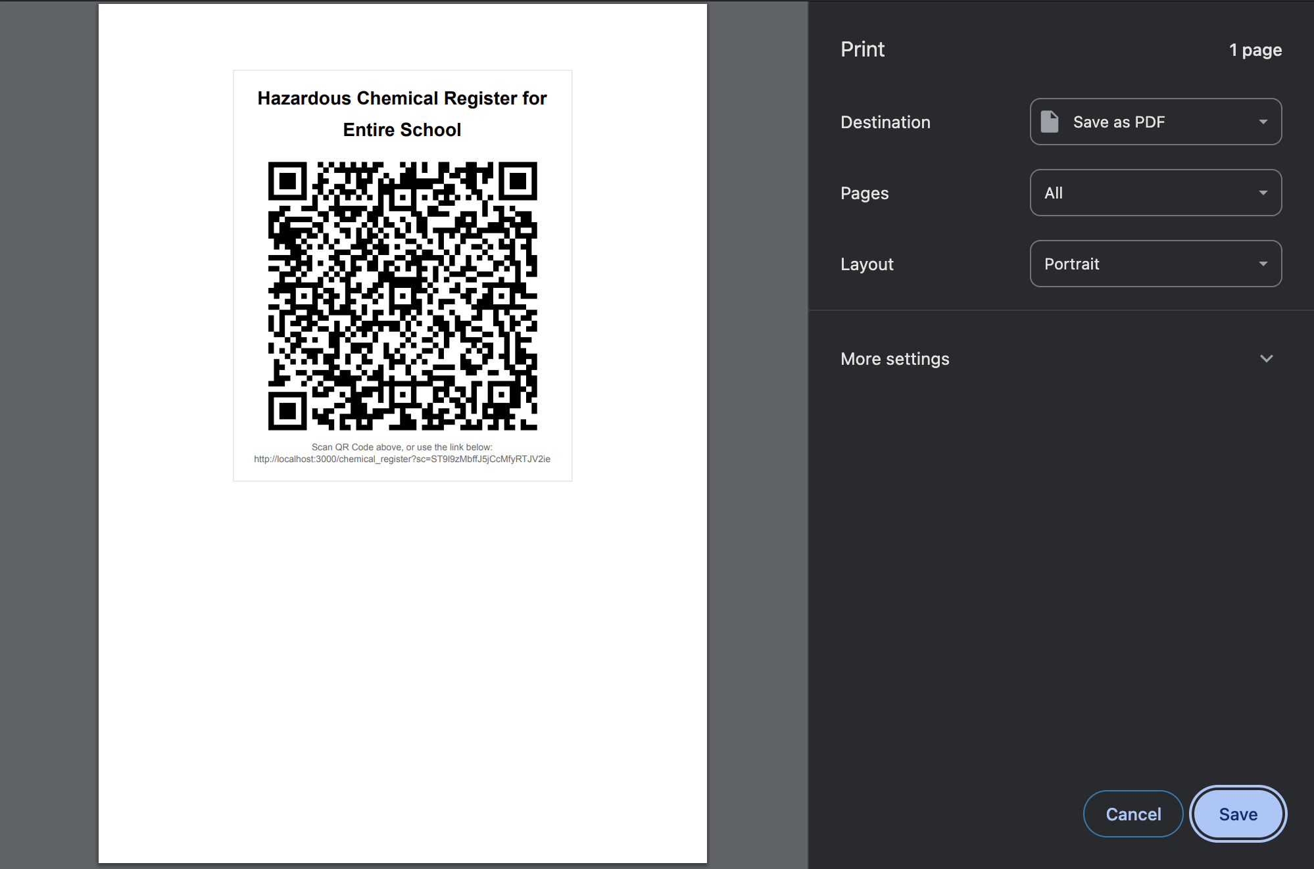
… and printed

Slide 5
Choosing a gem -> SVG
▪ socketry/qrcode – 58 st / 1 f, recent commits, SVG
▪ barby – 855 st / 175 f, last commit 2yr ago, many barcodes types & outputs including SVG
▪ rqrcode – 2k st / 241 f, recent commits, SVG & PNG
▪ rqrcode_core – 59 st / 26 f, recent commits, binary & ascii outputs
▪ libqrencode – 3k st / 628 f, last commit 6yr ago, native components

Slide 6
rqrcode.. But PNG??
▪ We only want SVG
▪ Image libs: memory safety, CVEs.
▪ Reachable? Maintenance?
▪ Trade off
github.com/jcrispw/rqrcode/commit/4fedca0551ba5c4515f9dbd63dff566a3ad86d4e

Slide 7
Generating the QR code…
share_controller.rb
def show
require 'rqrcode'
@share_url = "https://..."
@qr_svg = RQRCode::QRCode.new(@share_url).
as_svg(viewbox: true, use_path: true)
end
share.html.haml
.qr_svg= raw @qr_svg
viewbox: true — no fixed size, CSS decides.
use_path: true — one path, not 900 rects.

Slide 8
Layered Test Coverage
▪ Controller spec
share_controller_spec.rb
expect(assigns(:qr_svg)).to include("<svg")

Slide 9
E2E / Feature Testing
▪ Just decode it?
▪ Screenshot: multi-driver
▪ Decoding: gem or native
▪ Most likely failure?

Slide 10
1/2 way house
share_spec.rb
def assert_qr_rendered(svg)
view_box = find(svg)[:viewBox].to_s.split
expect(view_box[2]).to eq view_box[3] # square module grid
expect(view_box[2].to_i).to be >= 21 # version-1 grid or bigger
expect(find("#{svg} path")[:d].to_s.length).to be > 500 # not blank
end

Slide 11
But wait…
share_spec.rb
school_qr = find(".qr_svg svg path")[:d] # the entire-school QR
select "Building 4 - Chemical store", from: "location"
assert_qr_rendered(".qr_svg svg") # still a valid QR...
expect(find(".qr_svg svg path")[:d]).not_to eq school_qr # ...different URL

Slide 12
Recommendations
▪ Choose simplest which looks popular and maintained, with least dependencies. (AI) review.
▪ Use SVG - scales, easily testable and requires no additional gem
▪ Unused gems are still potential security risks (also in Rails, e.g. ActiveStorage)
▪ To Fork or not to Fork? Update freq, mergeability
▪ Test, but balance coverage / performance / risk

Slide 13
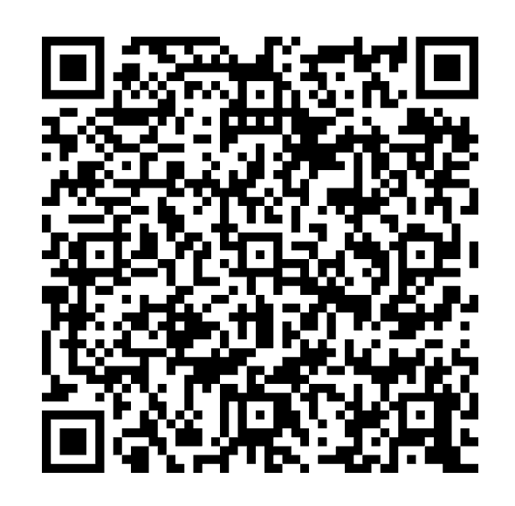
Questions?
github.com/jcrispw/rqrcode/commit/4fedca0551ba5c4515f9dbd63dff566a3ad86d4e

