Slide 1
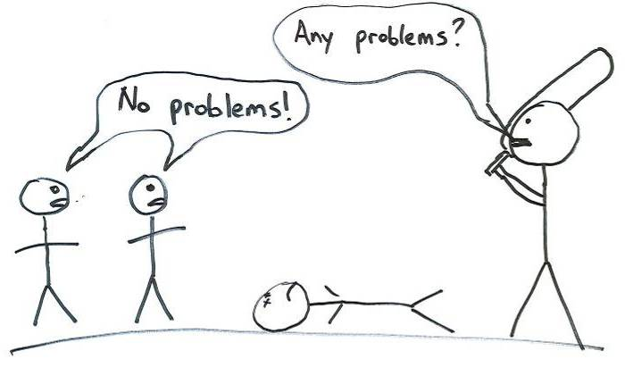
The Ultimate ALM Environment (circa 2010)
James Crisp, .NET lead for Oz
ThoughtWorks Australia

Slide 2
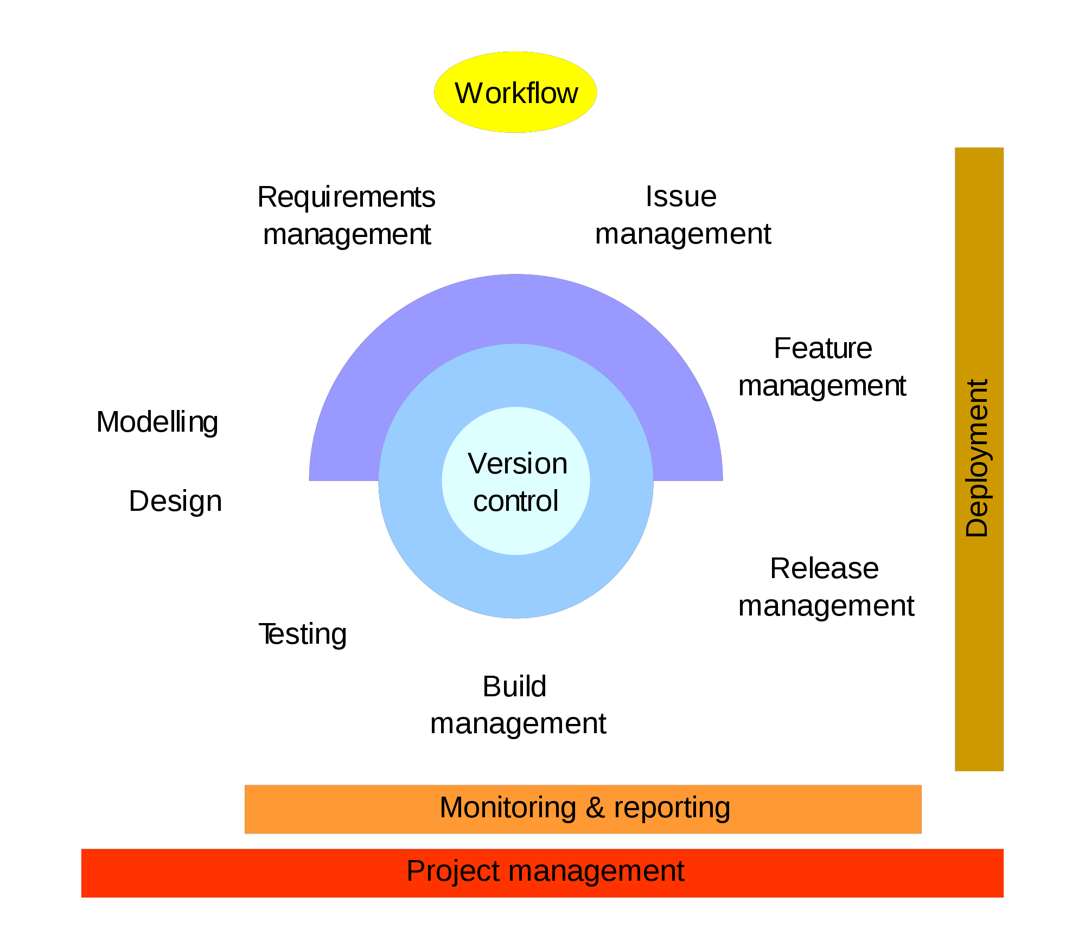
Source: Wikipedia (http://en.wikipedia.org/wiki/Application_lifecycle_management)
Notes:
On Wikipedia, there's this picture representing the concepts of ALM…
Simple enough but we don't really like it. ALM is very tool-focused and is therefore at great risk to place too much emphasis on the WHAT of ALM and not enough on the WHY. So, important question...What's the point of ALM? We need to know this to determine the ultimate environment! And we don't want the reflexive, vendor-speak, response. When it comes down to it, the goal of Application Lifecycle Management is to make the application development lifecycle more effective.

Slide 3
Effective
Productivity
Quality
Cost
Morale
Notes:
What does "effective" mean exactly?
"Effective" fundamentally comes down to a few things:
Higher productivity - start-to-end lead time, more delivered in less time
quality – external quality, meeting stakeholder outcomes (users, owners, maintainers)
cost - by reducing effort
morale - improved job satisfaction, that is, not interfering with work but supporting it
And we should think about this across multiple applications, that is, our application development system rather than any one particular application.

Slide 4
“How is time being wasted?”
“Why are stakeholders not satisfied?”
“How is money being wasted?”
“What makes the work unpleasant?”
Notes:
If we accept the goal and we accept our definition of effective, then these are the types of questions we should be asking when we look at each concept in ALM.
Let's walk our way through an application lifecycle and try this... What we’re going to do is look at a stage of in an application life cycle, think about the typical major problems in that area, use that to determine criteria to assess the effectiveness of an ALM environment to address those problems, and then describe how we would solve this problem today.

Slide 5
Requirements Management
Feature
Management

Slide 6
Notes:
Approximately 60 odd percent of features are rarely or never used. This will vary from place to place and we're not entirely confident with the methodological approach but most places we've been to tend to nod their heads when given this number. In short, what wastes the most time and money with requirements and features is simply having way too many of them. “Requirement” is a misnomer.

Slide 7
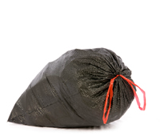
Source: Jeff Patton (http://agileproductdesign.com/blog/the_new_backlog.html)
Notes:
Quality is more about building the wrong thing and not achieving the right outcome. A major cause here is an inability to maintain the connection from details back to the overall picture. We spend a lot of effort figuring what the tree looks like but then turn this into a bag of leaves.

Slide 8
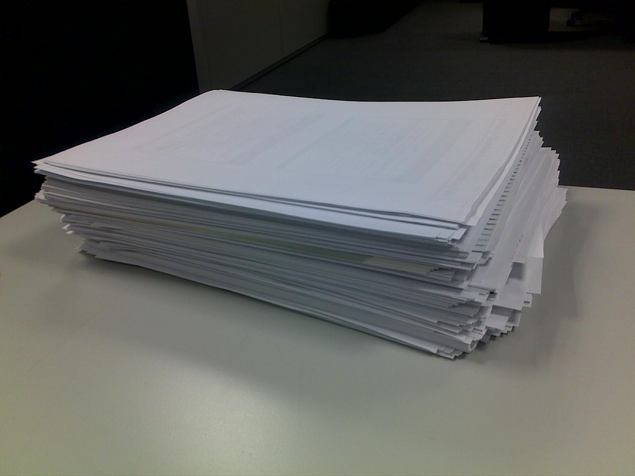
[Placeholder for requirements document / process]
Source: http://www.flickr.com/photos/dblancquaert/4245076510/sizes/l/
Notes:
What people dislike about requirements are excessive documents. Never mind the time spent writing. It's the excessive cycles of review and sign-off, changes -> review -> sign-off, etc. A recent phrase I heard from a business representative consumer of one of these things highlights the problem: "Give me something that I can actually understand"

Slide 9
Criteria
Encourages deferring detail
Encourages “requirement” prioritisation
See the “Tree”
Encourages less documents & cycles
Designed for information consumers

Slide 10
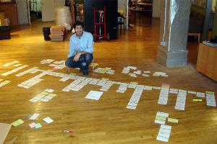
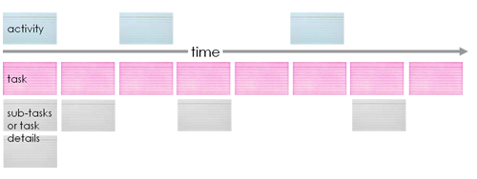
Source: Jeff Patton on Story Maps (http://agileproductdesign.com/blog/the_new_backlog.html)
Notes:
Story maps
High level category / activity at the top, and have them in the order you would describe the system in. Eg, for online account: online sign up, personal details verification, account activation
Drill down for details, keeps context.

Slide 11
Project Management
Workflow
Monitoring & Reporting
Issue Management

Slide 12
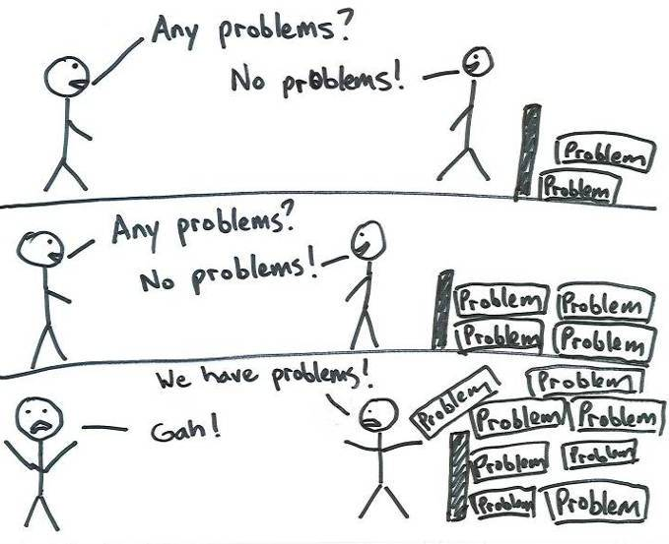
Notes:
Have you experienced this before? How about when projects are all green status until the very last moment when all of a sudden it’s red?
The essence here is the principle of “No problem is a problem”
Options disappear over time, the later you know about something, the more expensive it is to fix and the less likely you can do anything about it.
It just wastes time, money, and doesn’t make anyone happy.

Slide 13
Notes:
Intuitively people will agree with the concept of “no problem is a problem” so what stops problems from being reported?
One reason is that people are punished for raising problems. A subtle way to do this is to say “don’t come to me with a problem unless you have a solution”.

Slide 14
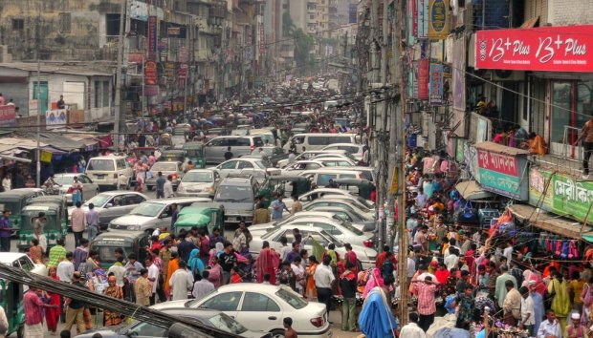
Source: http://www.flickr.com/photos/joiseyshowaa/2402764792/sizes/o/
Notes:
If we want to optimise a highway, do we shove as many cars (and people in this case) on the road as possible? Nah, we optimise for throughput, not utilisation. So why do we optimise programs by shoving too many projects in? And optimise projects by trying to do too many things at the same time?
This tends to lead to too much waiting and delays caused by coordination problems - hand-offs, lack of attention to availability, multi-tasking hiding delays

Slide 15
The 15 minute meeting
that takes
2 weeks to coordinate
Notes:
Have you ever had this happen? So another significant problem, too much waiting and delays caused by coordination problems - hand-offs, lack of attention to availability, multi-tasking hiding delays

Slide 16
http://www.flickr.com/photos/
usag_kaiserslautern/2750224436/
Notes:
If you asked, how many people on projects know exactly what to work on next, what's important, what is not? How explicit is this knowledge? How consistent is it?
In many cases, people don’t know or believe they do but are inconsistent.

Slide 17
Criteria
Exposes flow and problems
Limits work in process
Exposes clear priorities

Slide 18
Planned
In Progress
Acceptance Testing
Signed-Off
Priority
Iteration Progress
Notes:
We use story walls (also known as task boards or kanban boards) to make both the process and the status of work items explicit and highly visible. We use limits on how many cards are allow in an iteration or even in any stage to prevent assigning more work than is productive. The order in which the cards are laid out communicate very clearly and explicitly the current understanding of priority.

Slide 19
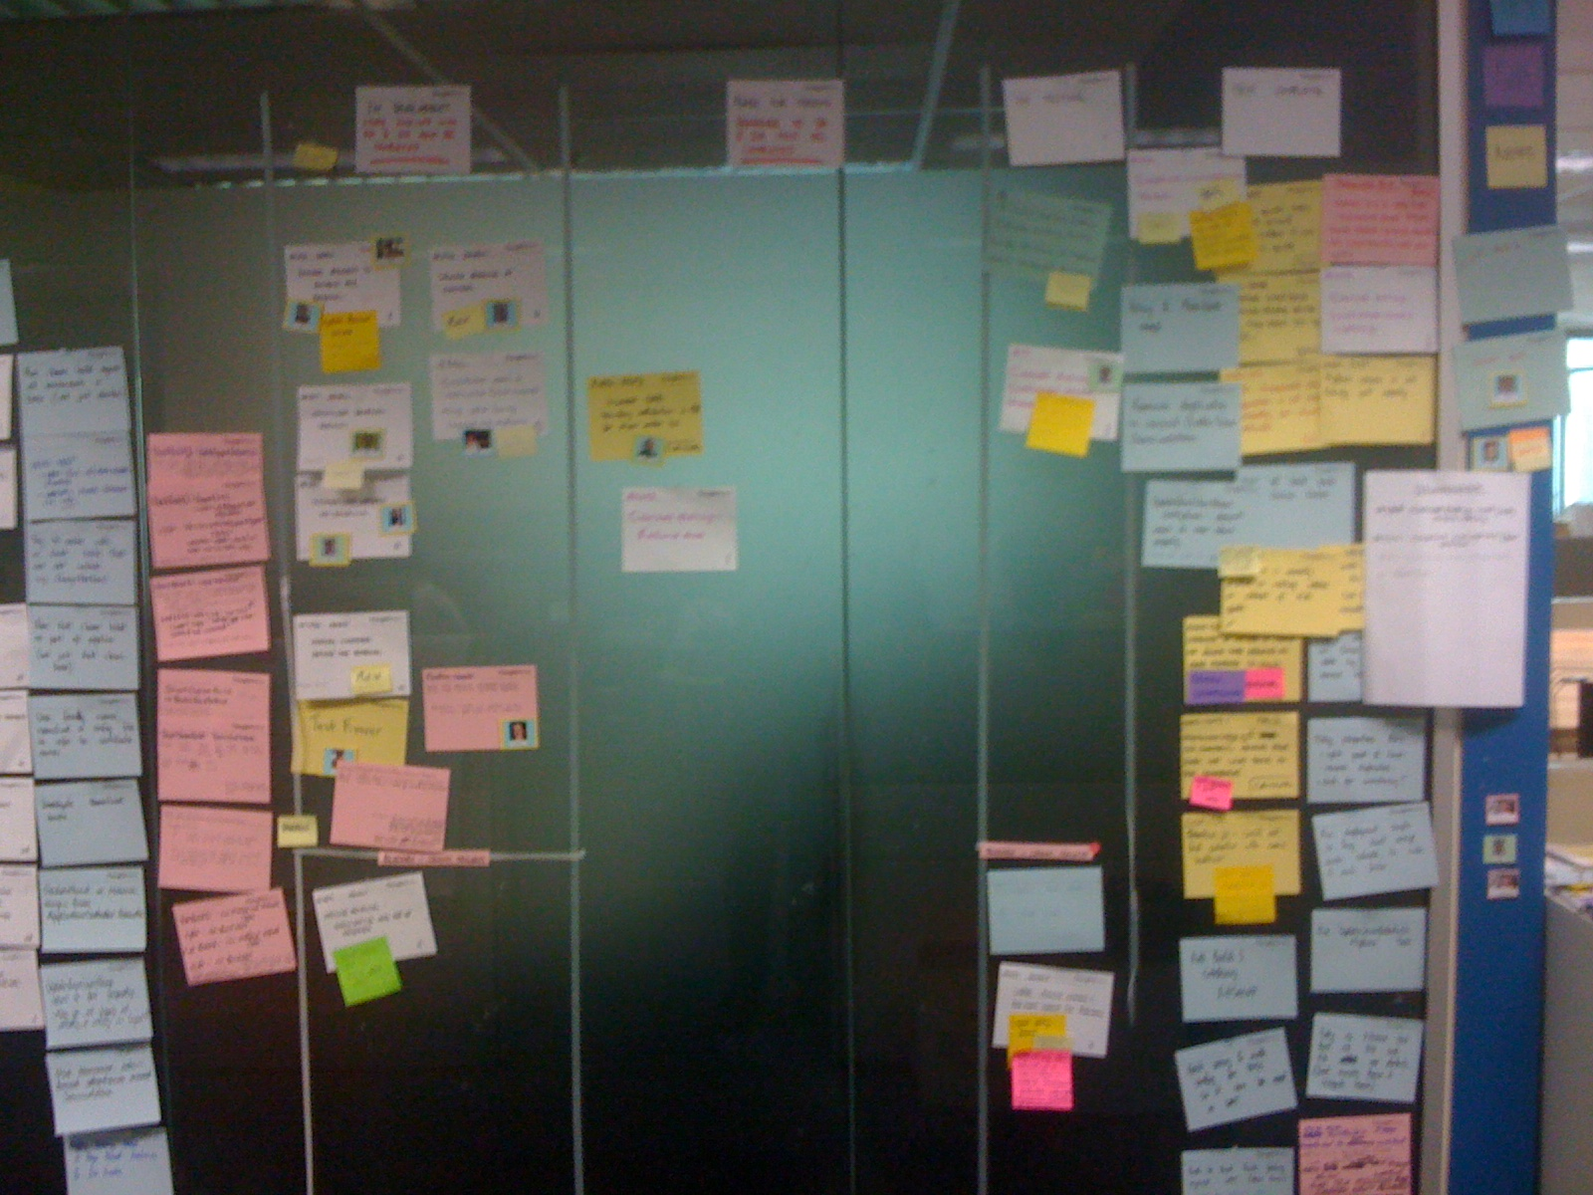
Notes:
Notice red cards for defects in same prioritisation mechanism as features, sticky notes for problems and blockers, and avatars (people’s faces) or cards so you can see who’s working on what

Slide 20
Trend
Total scope
Scope (story points)
Actuals
Expected
Completion
1
2
3
4
5
6
7
8
9
10
Time (Iterations)
Notes:
Burn up chart, see when project will finish, scope changes, trend line etc.

Slide 21
Design
Modeling

Slide 22
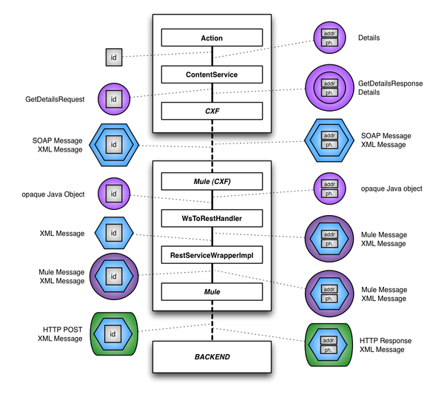
Source: http://erik.doernenburg.com/2009/07/making-esb-pain-visible
Notes:
We waste time and money in design when we succumb to
overcomplicated design (example here), sometimes due to anticipating features that will never be required, desire to incorporate buzz words and sometimes due to not being disciplined enough in keeping things simple
- wishful thinking -> design based on limited to no concrete evidence -> rework
closing off alternatives too early -> rework
4 layers of wrapping / unwrapping. ESB not required. Much faster deliver after it was removed.

Slide 23
“I’m glad we’re all agreed then.”
Notes:
Not designing towards the same target – client experience with horizontal layering. Different goals between teams/layers. Ie, build innovative user experience website with fast time to market, vs integration competency centre for mainframe integration, vs mainframe product customisation
We use this diagram to show the problems with requirements but the same phenomenon occur with designs. The design context does not survive the application development life cycle -> inconsistent design vision -> confusion and wasted time and money
Also designs may not consider operational issues (maintenance, scalability, reliability, supportability, etc.) because that expertise is not involved in the discussion at all.

Slide 24
Criteria
Encourages keeping things simple
Low cost exploration of multiple options
Evidence based
Easily accessible to stakeholders

Slide 25
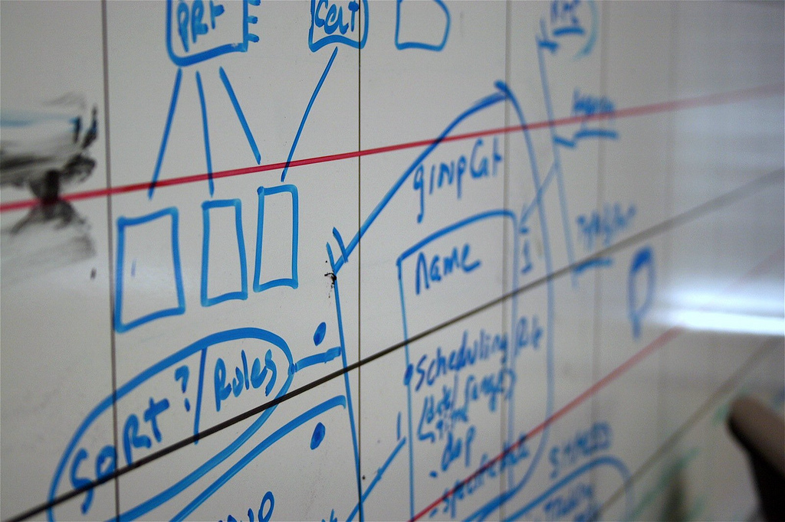
Source: http://www.flickr.com/photos/brylyn/279973066/
Notes:
Low cost exploration of alternatives, people don’t get bogged down in how the diagram looks, get group of people to discuss, take photo to make more permanent record if useful

Slide 26
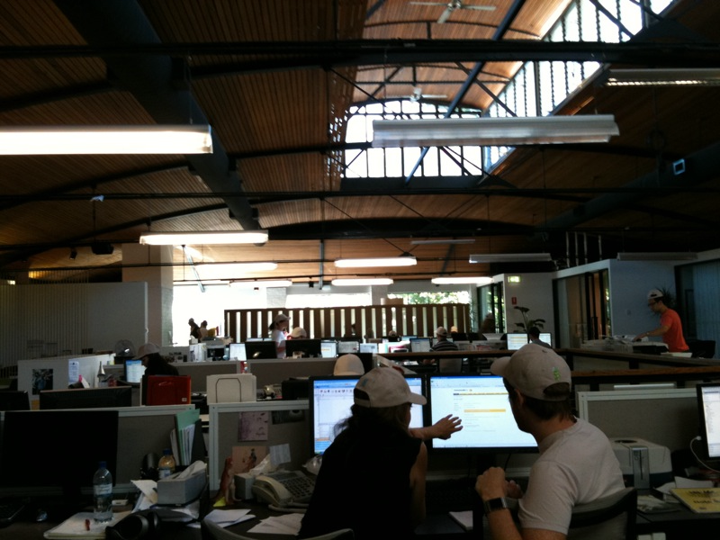
Source: http://www.flickr.com/photos/pcalcado/4201682728/sizes/o/in/set-72157604854195771/
Notes:
Evolutionary design, hands on code and refactoring. Do spikes on your architecture and integration points to work out if architecture ideas are any good in reality. Is there too many layers / wasted time? Will X and Y really work together?

Slide 27
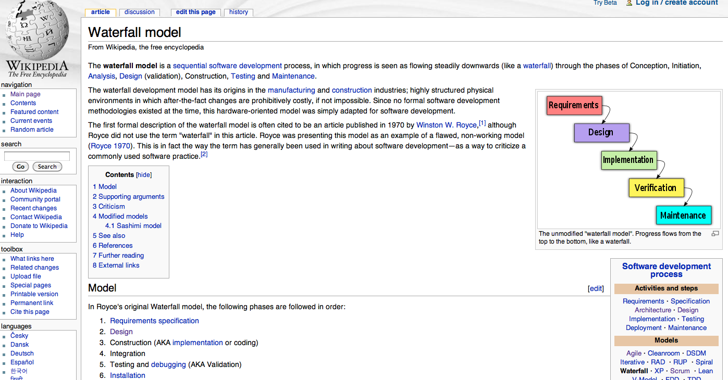
Notes:
More enduring documentation on the wiki. Great to being kept up to date by team.

Slide 28
Testing

Slide 29
“[Manual] testing is our bottleneck”
-- Head of Technology, at a recent client
Notes:
Regression testing costs too much and takes too long -> insufficient testing
Environment setup usually is a large portion of this.
Client where small change 2 days dev takes 3-6 months to reach production due to env problems, and full manual regression test taking 2 weeks by 2 testers required.

Slide 30
“Manual scripted testing should be
a human rights violation”
-- Martin Fowler
(http://twitter.com/martinfowler/status/2273044056)

Slide 31
Criteria
Support fully automated testing
Support automation assisted testing
Easily accessible to stakeholders
Scalable & Fast

Slide 32
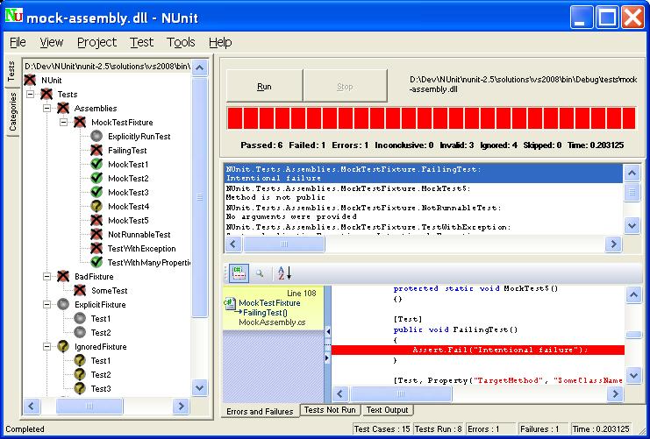
Notes:
Advantages of Nunit such as can run on build server without license, it’s fast, active development, defacto standard, ide integration with resharper etc

Slide 33
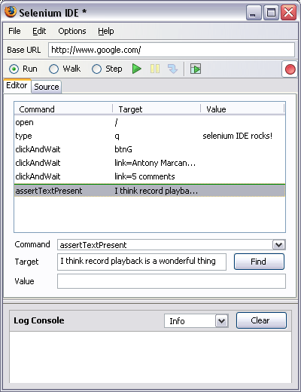
Notes:
Automation assisted testing with Selenium IDE.. But this is just the start. Scalable testing using C# and Selenium RC to send acceptance tests out to farm of test servers. Multi-browser compatibility testing. Page model in C# for abstraction from GUI changes. Other options such as Watir etc.

Slide 34
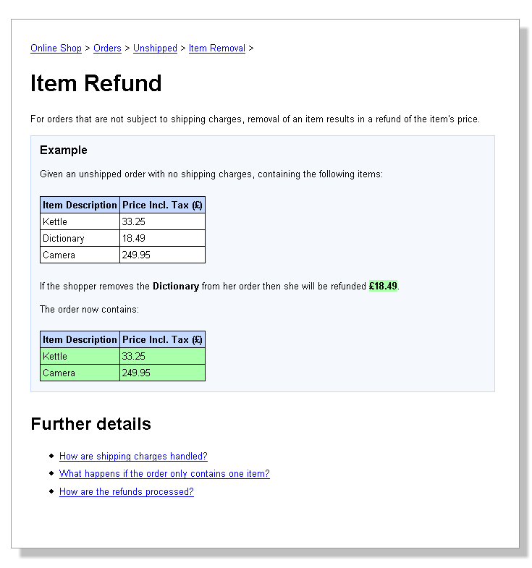
Notes:
Concordion handy if your business is really involved and happy to write test cases, or some document format that you require, but you want to make executable.

Slide 35
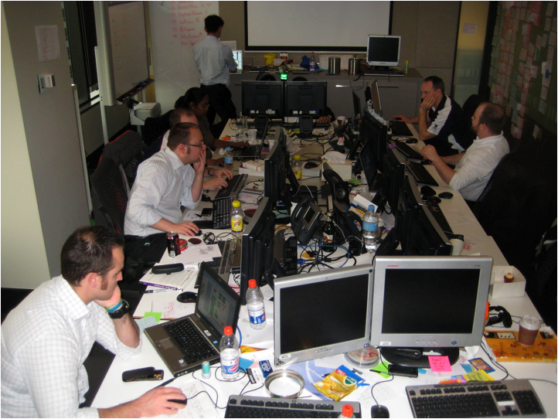
Notes:
Co-location of testers & developers. Saves time and increased quality. Tester working on stories in current iteration, just grabs dev sitting near by to show them problem, they quickly resolve. No need to log in bug tracking system etc.

Slide 36
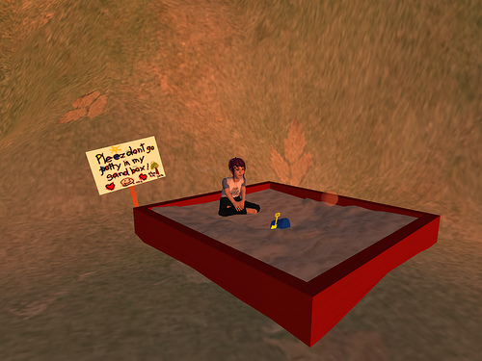
Source: http://www.flickr.com/photos/jjacek/2619935342/
Notes:
Developer and tester sandbox for major productivity improvements

Slide 37
Desktop
Sys Test
Dev
Pre Prod
UAT
Production
Notes:
Environments in increasing order of closeness to production, and tests which are capable of working on all environments

Slide 38
Build
Release Management
Deployment

Slide 39
Slow Unreliable
Inconsistent

Slide 40
Criteria
Fully automated, visible build
Fully automated deployment
Fully automated environment creation
Support for multiple environments

Slide 41
Build Scripting
Ant / MS Build / NAnt
Rake / nRake
Powershell
Notes:
NRake on GitHub! Much more powerful than XML based builds. Powershell pSake still a bit immature.

Slide 42
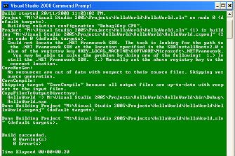
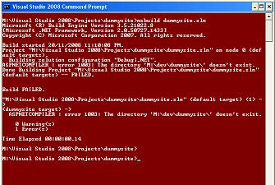
Notes:
Local build on dev workstation. Red green batch file trick for visible feedback (see my blog for batch file trick).

Slide 43
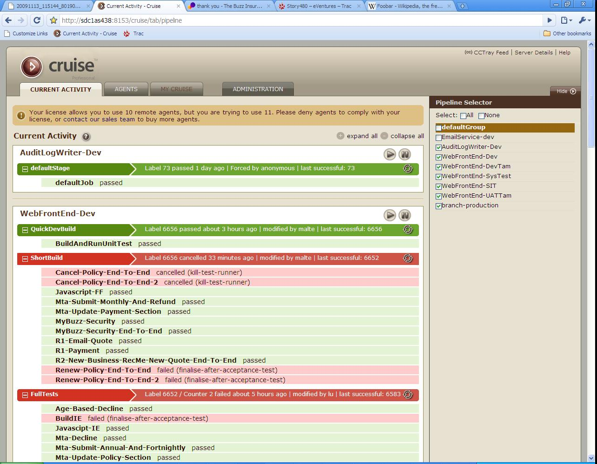
Notes:
Or Team foundation build, Team City etc. But it’s got to be able to run on check in, show test results, drill down for test failures, store artifacts like code coverage, and versioned build artifacts for automated deployment.

Slide 44
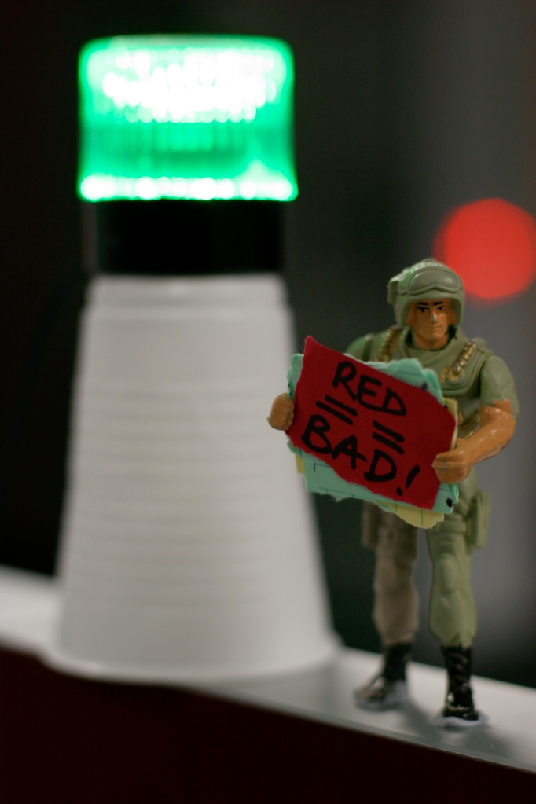
Source: http://www.flickr.com/photos/joshprice/1070730465/
Notes:
Visible build indicator

Slide 45
Source: http://www.flickr.com/photos/mukluk/311712807/
Notes:
Push button deployments

Slide 46
Notes:
Powershell for windows
Cap & Ruby for linux environment

Slide 47
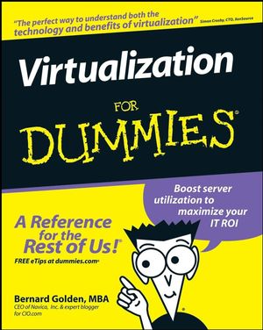
Notes:
Create and tear down environments at will

Slide 48
Development
Version Control

Slide 49
Criteria
Minimise administrative overhead
Integrated Refactoring
Integrated Testing
Integrated Version Control

Slide 51
Notes:
DVCS use faster underlying protocols. Local repos. Push/Pull rather than shelving for sharing between people. Keep trunk line repo with CI.

Slide 52
“Ultimate” ALM Environment
Physical workspace is deliberately designed to expose information
Automated test, build, environment creation and deployment
Supporting the creativity and interaction of people
Notes:
Choose what suits your environment rather than swallowing an entire vendor package

Slide 53
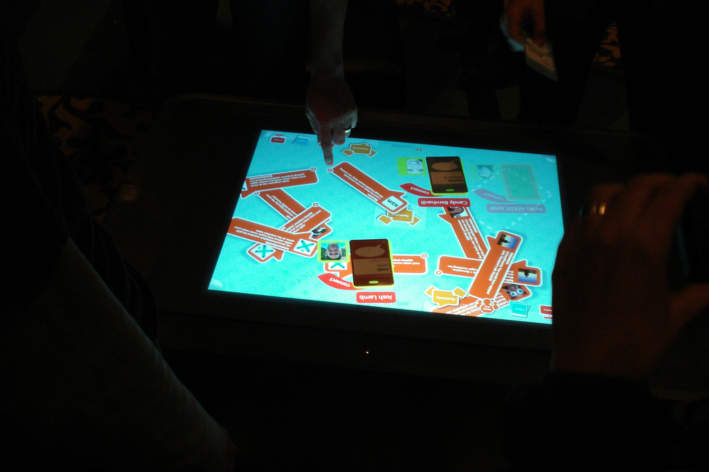
Source: http://www.flickr.com/photos/larskflem/3262269450/
Notes:
What does the future hold? Story walls on surfaces? We’ve talked about what we think are the best practices and tools in 2010, but this is just a snapshot in time in a constantly evolving area.
We’ve talked about the criteria for evaluation and we hope this is something that will help you in the longer term.

Slide 54
?
Questions

